Slide 1
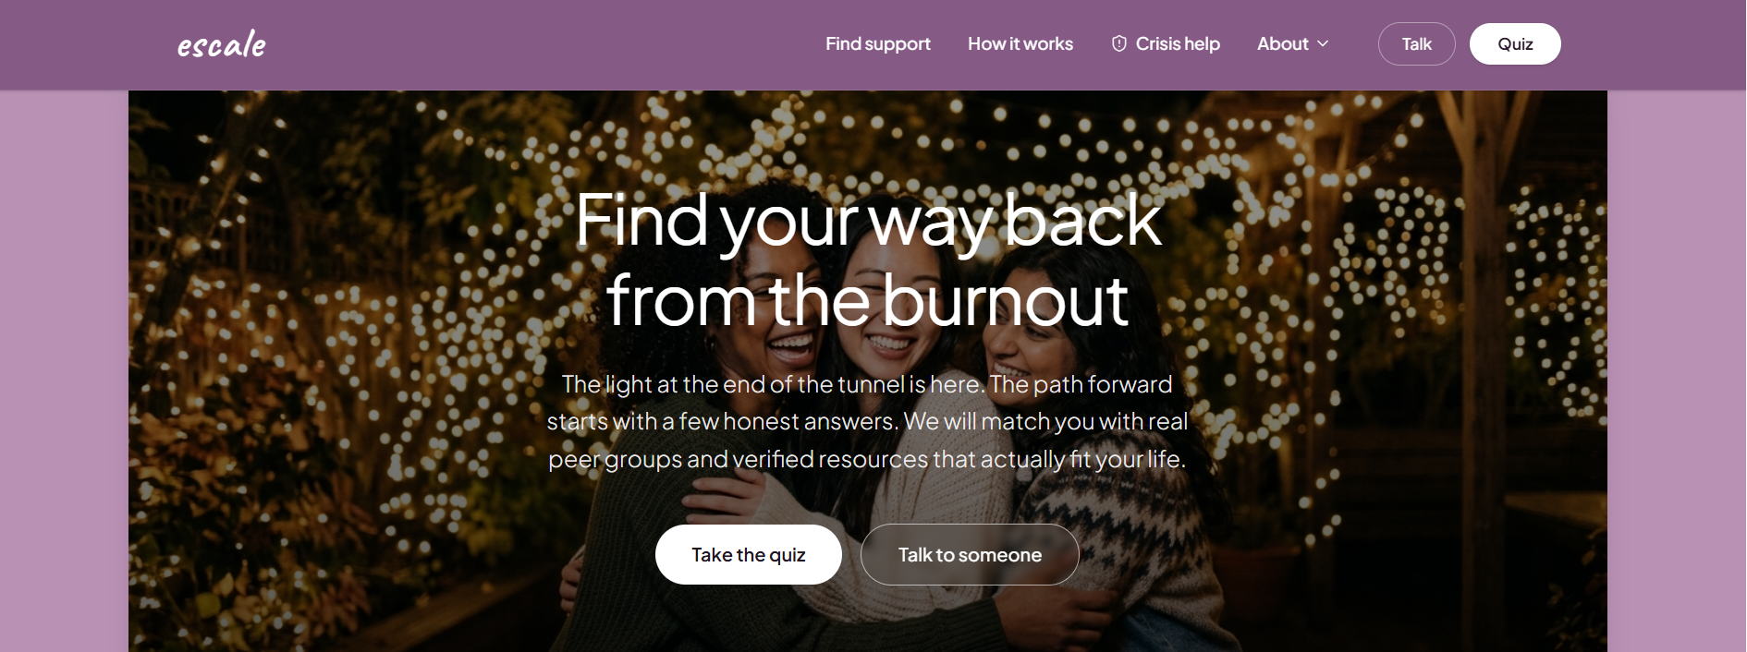
MMC PORTFOLIO CAPSTONE · UX DESIGN TRACK
escale
Finding the Way Back from Burnout
A guided routing platform that matches burned-out professionals and caregivers with verified peer support groups and low-cost resources — in under two minutes.
escale.app — landing experience
“The light at the end of the tunnel is here. The path forward starts with a few honest answers.”
UN SDG ALIGNMENT
Goal 3 — Good Health & Well-Being
DISCIPLINE
UX Design
PROJECT TYPE
Solo Capstone Project
PHASE
BUILD Phase · Jul 13 – Aug 2, 2026
01

Slide 2
01 · PROBLEM IDENTIFICATION
Burnout is everywhere. Support is a maze.
Millions of professionals recognize their own exhaustion but stall at the very next step: finding help that actually fits their job, budget, and bandwidth.
76%
53%
1,000+
of employees report experiencing burnout at least sometimes in their work (Gallup).
of employees know how to access the mental-health support their employer already offers (NAMI).
generic results returned by a typical “burnout help near me” search — with no way to tell what fits.
WHY EXISTING RESOURCES FAIL
Decision paralysis
Dead, unverified links
One-size-fits-all
Long directories with no filtering by career stage, energy level, or budget leave people scrolling instead of healing.
Community lists go stale; broken links and defunct groups erode trust at the exact moment someone reaches out.
A software engineer, a nurse, and an unpaid caregiver are pointed to the same generic hotline — none of it feels relevant.
02

Slide 3
02 · RESEARCH AND ANALYSIS
Listening before designing
Discovery combined qualitative interviews, competitive audits, and a review of existing digital-mental-health directories to pinpoint exactly where seekers give up.
1
User Interviews
2
Competitive Audit
KEY INSIGHT
“Route me, don’t diagnose me.”
12 informational interviews with burned-out tech workers, healthcare staff, and family caregivers about their last attempt to find support.
Reviewed 15+ directories, hotlines, and wellness apps; logged broken links, jargon-heavy copy, and missing budget filters.
Every interviewee wanted a fast, low-effort match to real options — not another self-assessment that ends in a wall of text. This reframed the product from a “treatment app” into a lightweight, anonymous routing layer.
3
Persona Mapping
4
Data & Insight
Synthesized findings into three journeys — corporate/tech, healthcare shift workers, and unpaid caregivers — each with distinct triggers and constraints.
Cross-referenced open datasets (Global Health Observatory, Data.gov) on workplace stress prevalence to validate scope and urgency.
03

Slide 4
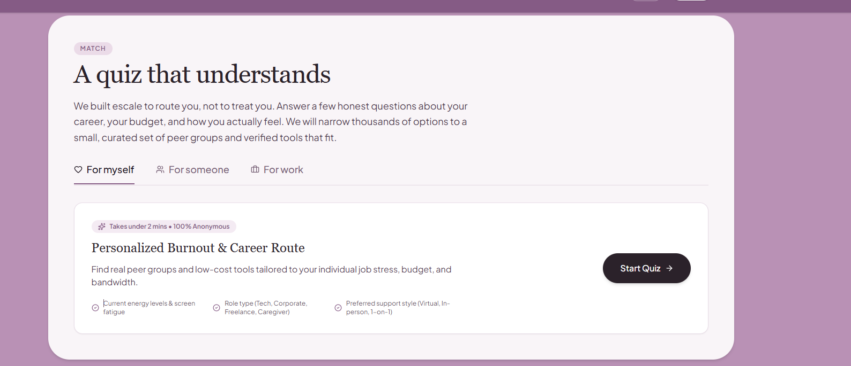
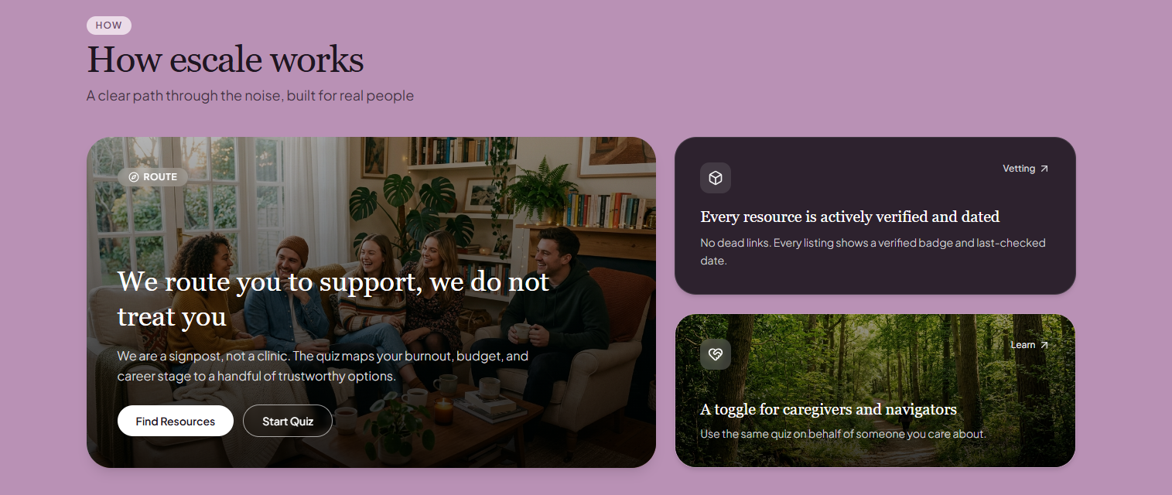
03 · SOLUTION DEVELOPMENT
Introducing escale
escale is a signpost, not a clinic. A two-minute, 100% anonymous quiz reads a person’s energy level, role, and preferred support style, then narrows thousands of possible resources down to a small, trustworthy shortlist.
1
Personalized quiz
Matches on energy & screen fatigue, role type, and preferred support style (virtual, in-person, 1-on-1).
2
Three entry points
The quiz landing screen — reduces a wall of resources to one guided path.
“For myself,” “for someone,” and “for work” flows so caregivers and managers can route on someone else’s behalf.
3
Plain-language design
No clinical jargon — copy is written the way a trusted friend would explain the next step.
04

Slide 5
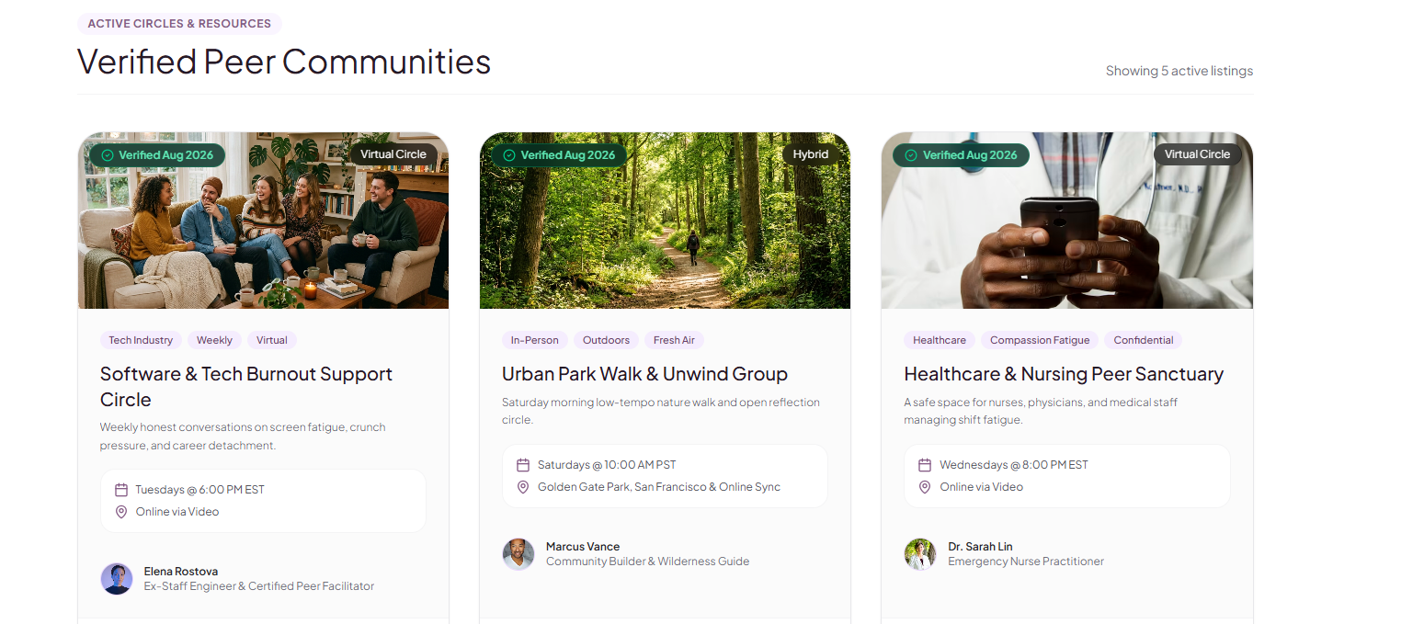
03 · SOLUTION DEVELOPMENT (CONT.)
Trust, verified down to the date
Every peer group, digital tool, and professional resource in escale is actively vetted and time-stamped — no dead links, no guesswork.
Live browse view: verified peer communities, each showing a facilitator, schedule, and “Verified” badge.
Verified Aug 2026
48 active peer groups
Privacy-first
Every listing is re-checked on a recurring cadence and displays its last-verified date.
Spanning tech burnout, caregiving, healthcare, neurodivergent spaces, and general burnout.
100% free for seekers; no data sharing with employers or third-party ad networks.
05

Slide 6
04 · IMPLEMENTATION PLAN
From prototype to public launch
PHASE 1
PHASE 2
PHASE 3
PHASE 4
Research & Planning
Design & Prototype
Build & Populate
Launch & Evaluate
Finalize personas, information architecture, and the quiz-logic decision tree; select the initial 4 resource categories.
Build high-fidelity screens (home, quiz, browse, listing detail); usability-test the quiz flow with 5–8 target users.
Develop the routing quiz and browse/search interface; source and verify the first 48 peer-group and resource listings.
Ship the MVP, monitor quiz completion and match-click-through rates, and refresh verification dates on a recurring cycle.
RISK MANAGEMENT
Low initial listing supply
Listings go stale post-launch
Users mistake it for a clinic
Recruit facilitators via warm outreach before launch; require a minimum of 3 listings per category before go-live.
Automated 90-day verification reminders keep the “Verified” badge and date accurate.
Persistent “we route, we don’t treat” messaging and a visible Crisis Help link in the nav.
06

Slide 7
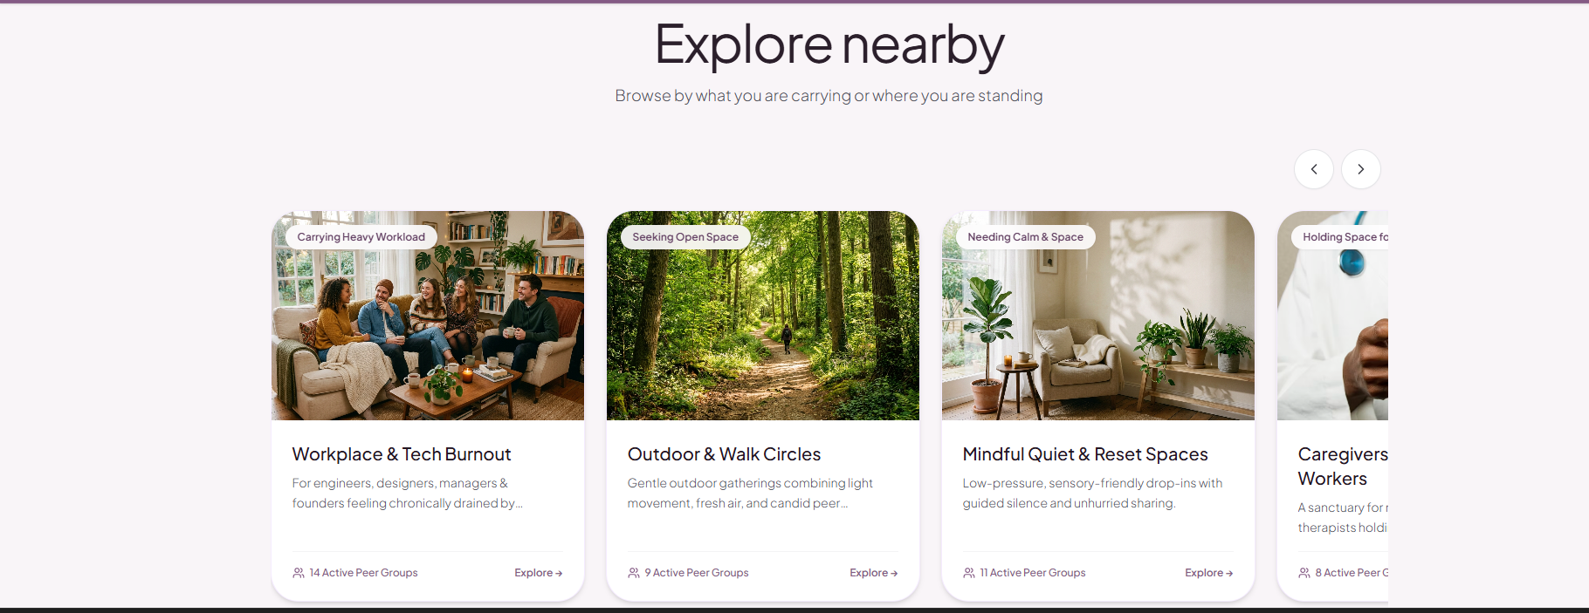
05 · IMPACT & OUTCOMES
Designed for Goal 3: Good Health & Well-Being
escale advances UN SDG 3 by closing the gap between recognizing burnout and actually reaching support — especially for populations underserved by traditional employer benefits.
Faster time-to-support
A 2-minute quiz replaces hours of directory scrolling with a short, curated shortlist.
Equity of access
Free-for-seekers model and a caregiver/navigator toggle extend reach to people who can’t self-advocate.
Sustained trust
Recurring verification keeps every listed resource live, current, and safe to recommend.
Segmented browsing lets tech workers, caregivers, and healthcare staff each find a community built for their specific strain.
07

Slide 8
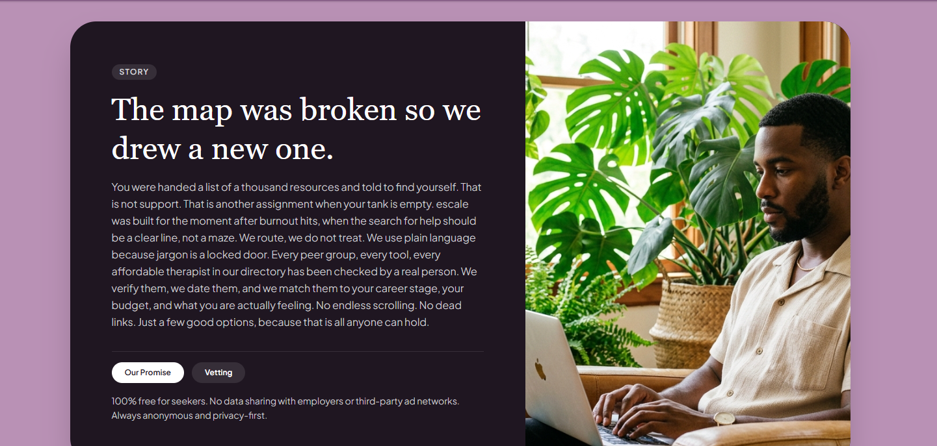
06 · DOCUMENTATION & NEXT STEPS
The map was broken, so we drew a new one.
Full documentation — problem statement, research synthesis, solution rationale, and implementation plan — is compiled in an 8-page project report, paired with an 8-slide / 5-minute video walkthrough for submission.
Project report
8 pages · problem, research, solution, implementation, outcomes
Video walkthrough
5 minutes · team intro, findings, and live product demo
Submission
PDF, deck, or video via the MMC capstone form by Aug 6, 2026, 11:59 PM EST
Thank you — questions welcome.
08

